Slide 1
MATLAB for Engineering Applications Fifth Edition
William J. Palm III
© McGraw Hill LLC. All rights reserved. No reproduction or distribution without the prior written consent of McGraw Hill LLC.

Slide 2
Chapter 03
Functions

Slide 3
Getting Help for Functions
You can use the lookfor command to find functions that are relevant to your application.
For example, type lookfor imaginary to get a list of the functions that deal with imaginary numbers. You will see listed:
imag | Complex imaginary part
i | Imaginary unit
j | Imaginary unit

Slide 4

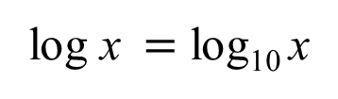
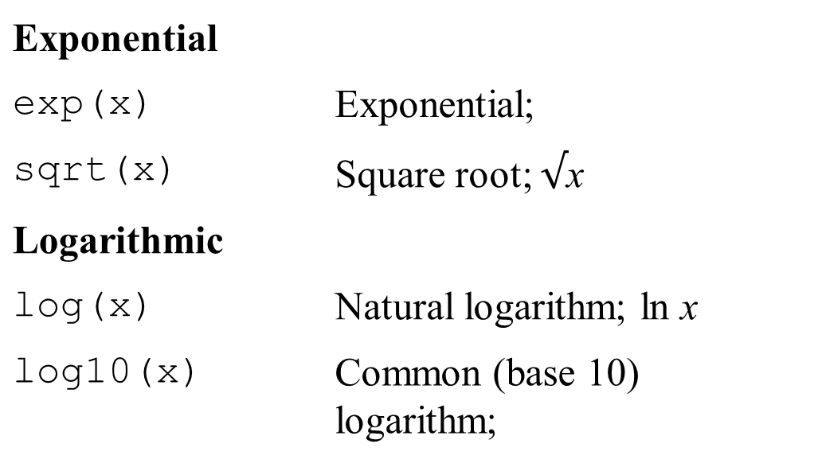
Common mathematical functions
Exponential
exp(x) | Exponential; e to the x power
sqrt(x) | Square root; $√$x
Logarithmic
log(x) | Natural logarithm; ln x
log10(x) | Common (base 10) logarithm; log x equals log sub 10 x
A table summarizes data divided into two subsections: Exponential and logarithmic. Column 1 has no header and notes symbol of function. Column 2 notes function.

Slide 5
Some common mathematical functions 1
Complex
abs(x) | Absolute value.
angle(x) | Angle of a complex number.
conj(x) | Complex conjugate.
imag(x) | Imaginary part of a complex number.
real(x) | Real part of a complex number.
A table summarizes data divided into a subsection: Complex. Column 1 has no header and notes symbol of function. Column 2 notes function.

Slide 6
Some common mathematical functions 2
Numeric
ceil(x) | Round to nearest integer toward ∞.
fix(x) | Round to nearest integer toward zero.
floor(x) | Round to nearest integer toward −∞.
round(x) | Round toward nearest integer.
sign(x) | Signum function: +1 if x > 0; if x = 0; −1 if x < 0.
A table summarizes data divided into a subsection: Numeric. Column 1 has no header and notes symbol of function. Column 2 notes function.

Slide 7
Operations with Complex Numbers 1
>>x = -3 + 4i;
>>y = 6 − 8i;
>>mag_x = abs(x)
mag_x =
5.0000
>>mag_y = abs(y)
mag_y =
10.0000
>>mag_product = abs(x*y)
50.0000

Slide 8
Operations with Complex Numbers 2
>>angle_x = angle(x)
angle_x =
2.2143
>>angle_y = angle(y)
angle_y =
-0.9273
>>sum_angles = angle_x + angle_y
sum_angles =
1.2870
>>angle_product = angle(x*y)
angle_product =
1.2870

Slide 9
Operations on Arrays
MATLAB will treat a variable as an array automatically. For example, to compute the square roots of 5, 7, and 15, type
>>x = [5,7,15];
>>y = sqrt(x)
y =
2.2361 2.6358 3.8730

Slide 10
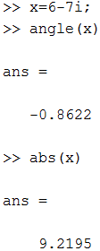
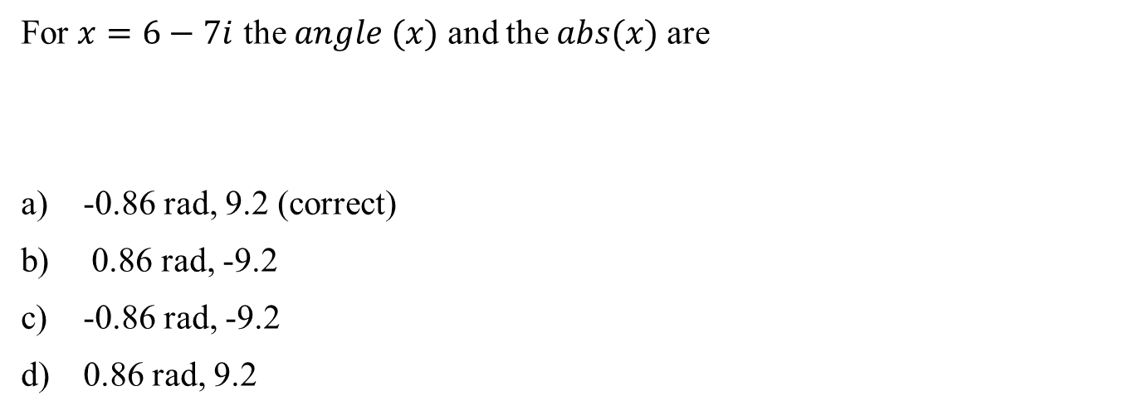
Question 1
For $x=6−7i$ the $angle (x)$ and the $abs(x)$are
-0.86 rad, 9.2 (correct)
0.86 rad, -9.2
-0.86 rad, -9.2
0.86 rad, 9.2

Slide 11
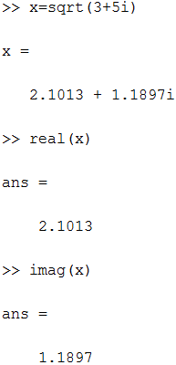

Question 2
Q2- Find the real part, and imaginary part of the $\sqrt{3+5i}$
3.2 , 2.3
2.1 , 1.2 (correct)
2.2 , 3.3
3.3 , 2.2

Slide 12
Expressing Function Arguments 1
We can write sin 2 in text, but MATLAB requires parentheses surrounding the 2 (which is called the function argument or parameter).
Thus to evaluate sin 2 in MATLAB, we type sin(2). The MATLAB function name must be followed by a pair of parentheses that surround the argument.
To express in text the sine of the second element of the array x, we would type sin[x(2)]. However, in MATLAB you cannot use square brackets or braces in this way, and you must type sin(x(2)).

Slide 13
Expressing Function Arguments 2
To evaluate
, you type sin(x.^2 + 5).
To evaluate sin(√x + 1), you type sin(sqrt(x)+1).
Using a function as an argument of another function is called function composition. Be sure to check the order of precedence and the number and placement of parentheses when typing such expressions.
Every left-facing parenthesis requires a right-facing mate. However, this condition does not guarantee that the expression is correct!

Slide 14
Expressing Function Arguments 3
Another common mistake involves expressions like
x,
which means
In MATLAB we write this expression as (sin(x))^2, not as sin^2(x), sin^2x, sin(x^2), or sin(x)^2!

Slide 15
Expressing Function Arguments 4
The MATLAB trigonometric functions operate in radian mode. Thus sin(5) computes the sine of 5 rad, not the sine of 5°.
To convert between degrees and radians, use the relation

Slide 16
Trigonometric Functions
cos(x) | Cosine; cos x.
cot(x) | Cotangent; cot x.
csc(x) | Cosecant; csc x.
sec(x) | Secant; sec x.
sin(x) | Sine; sin x.
tan(x) | Tangent; tan x.

Slide 17
Inverse Trigonometric Functions
acos(x) | Inverse cosine; arccos x.
acot(x) | Inverse cotangent; arccot x.
acsc(x) | Inverse cosecant; arccsc x.
asec(x) | Inverse secant; arcsec x.
asin(x) | Inverse sine; arcsin x .
atan(x) | Inverse tangent; arctan x .
atan2(y,x) | Four-quadrant inverse tangent.

Slide 18
Hyperbolic Functions
cosh(x) | Hyperbolic cosine
coth(x) | Hyperbolic cotangent.
csch(x) | Hyperbolic cosecant
sech(x) | Hyperbolic secant
sinh(x) | Hyperbolic sine
tanh(x) | Hyperbolic tangent

Slide 19
Inverse Hyperbolic Functions
acosh(x) | Inverse hyperbolic cosine
acoth(x) | Inverse hyperbolic cotangent
acsch(x) | Inverse hyperbolic cosecant
asech(x) | Inverse hyperbolic secant
asinh(x) | Inverse hyperbolic sine
atanh(x) | Inverse hyperbolic tangent;

Slide 20
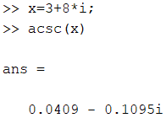

Question 3
For $x=3+8i$ the acsc$(x)$ is
-0.0409 - 0.1095i
0.0409 + 0.1095i
0.0409 - 0.1095i (correct)
-0.0409 + 0.1095i

Slide 21
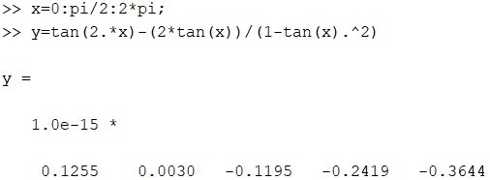
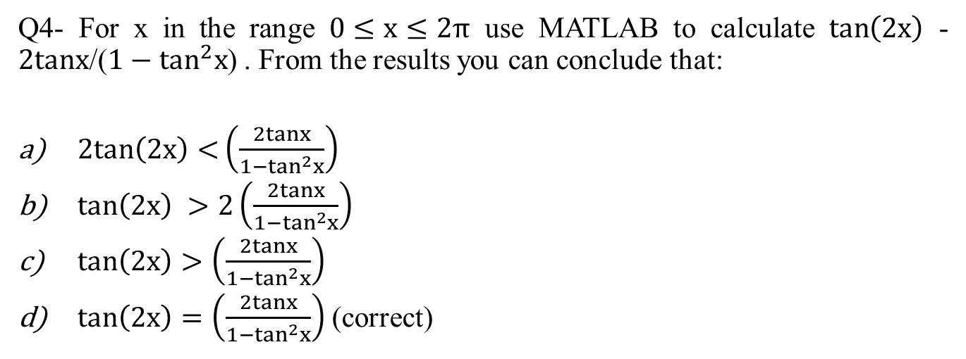
Question 4
Q4- For x in the range $0≤x≤2π$ use MATLAB to calculate $\tan\left(2x\right)$ - $2tanx$/($1−\tan^{2}x$) . From the results you can conclude that:
$2tan\left(2x\right)<\left(\frac{2tanx}{1−\tan^{2}x}\right)$
$\tan\left(2x\right) >2\left(\frac{2tanx}{1−\tan^{2}x}\right)$
$\tan\left(2x\right)>\left(\frac{2tanx}{1−\tan^{2}x}\right)$
$\tan\left(2x\right)=\left(\frac{2tanx}{1−\tan^{2}x}\right)$ (correct)
Very small y!

Slide 22
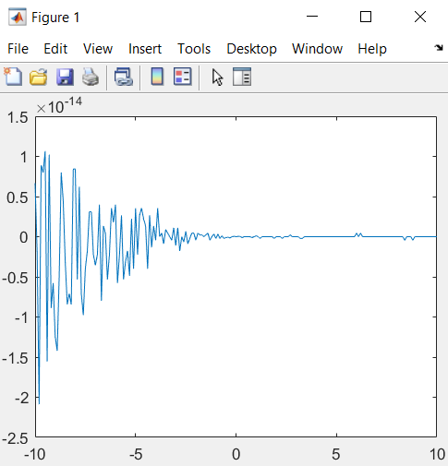

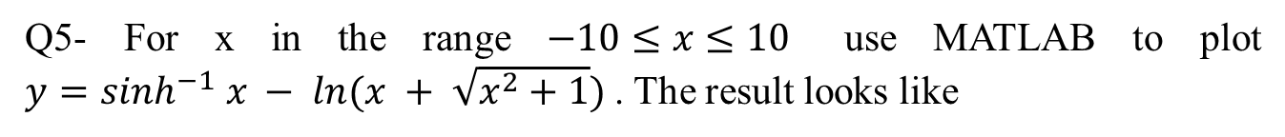
Question 5
Q5- For x in the range $−10≤x≤10$ use MATLAB to plot ${y=sinh}^{−1} x − ln⁡(x + \sqrt{x^{2}+1})$. The result looks like
Very small y!

Slide 23
User-Defined Functions 1
To create a function file, open the Editor as described in Chapter 1, by selecting New under the HOME tab on the Toolstrip, but instead of selecting Script, select Function. The first line in a function file must begin with a function definition line that has a list of inputs and outputs. This line distinguishes a function M-file from a script M-file. Its syntax is shown in the next slide.

Slide 24
User-Defined Functions 2
The first line in a function file must begin with a function definition line that has a list of inputs and outputs. This line distinguishes a function M-file from a script M-file. Its syntax is as follows:
function [output variables] = name(input variables)
Note that the output variables are enclosed in square brackets, while the input variables must be enclosed with parentheses. The function name (here, name) should be the same as the file name in which it is saved (with the .m extension).

Slide 25
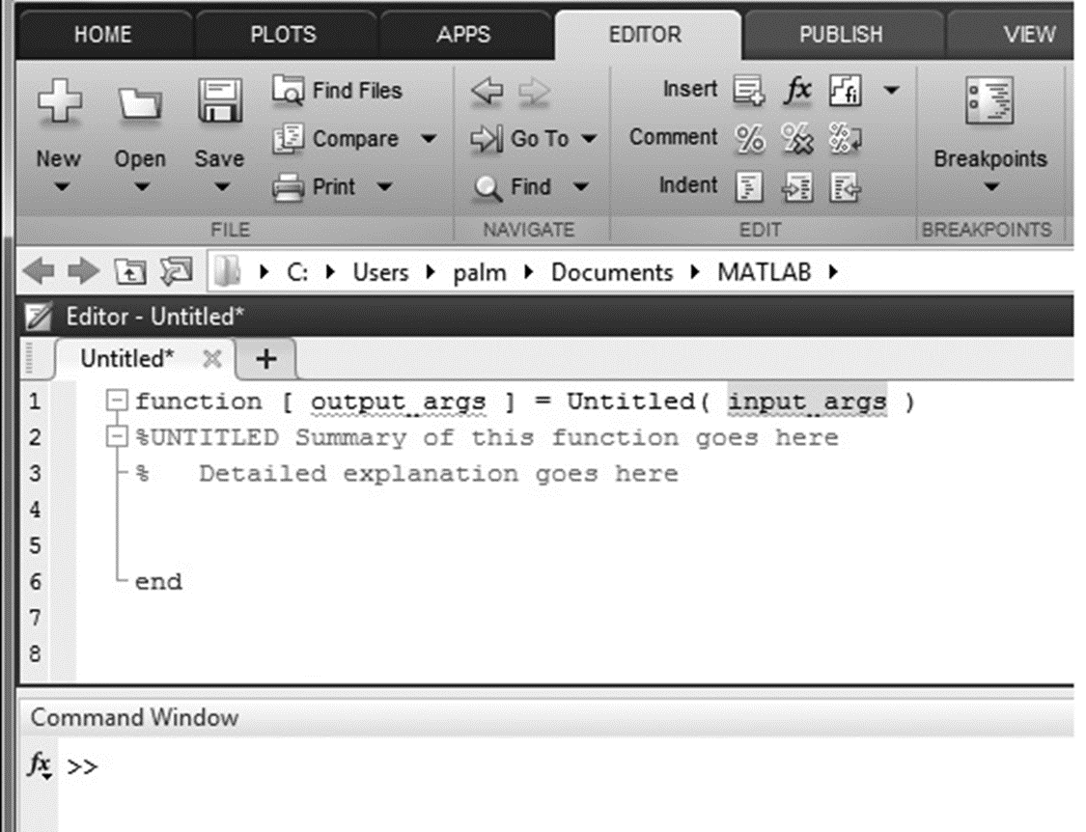
The default Editor Window when creating a new function 1
Access the text alternative for slide images.
Source: MATLAB

Slide 26
User-Defined Functions: Example 1
function z = fun(x,y)
u = 3*x;
z = u + 6*y.^2;
end
Note the use of a semicolon at the end of the lines. This prevents the values of u and z from being displayed.
Note also the use of the array exponentiation operator (.^). This enables the function to accept y as an array.

Slide 27
User-Defined Functions: Example 2
Call this function with its output argument:
>>z = fun(3,7)
z =
303
The function uses x = 3 and y = 7 to compute z.

Slide 28
User-Defined Functions: Example 3
Call this function without its output argument and try to access its value. You will see an error message.
>>fun(3,7)
ans =
303
>>z
??? Undefined function or variable ‘z’.

Slide 29
User-Defined Functions: Example 4
Assign the output argument to another variable:
>>q = fun(3,7)
q =
303
You can suppress the output by putting a semicolon after the function call.
For example, if you type q = fun(3,7); the value of q will be computed but not displayed (because of the semicolon).

Slide 30
Local Variables 1
The variables x and y are local to the function fun, so unless you pass their values by naming them x and y, their values will not be available in the workspace outside the function. The variable u is also local to the function. For example,
>>x = 3;y = 7;
>>q = fun(x,y);
>>x
x =
3
>>y
y =
7
>>u
??? Undefined function or variable ’u’.

Slide 31
Argument Order
Only the order of the arguments is important, not the names of the arguments:
>>x = 7;y = 3;
>>z = fun(y,x)
z =
303
The second line is equivalent to z = fun(3,7).

Slide 32
Arrays as Inputs
You can use arrays as input arguments:
>>r = fun(2:4,7:9)
r =
300 393 498

Slide 33
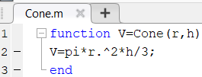
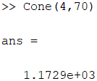
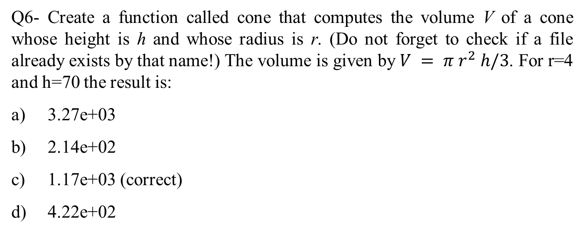
Question 6
Q6- Create a function called cone that computes the volume V of a cone whose height is h and whose radius is r. (Do not forget to check if a file already exists by that name!) The volume is given by $V = π r^{2} h/3$. For r=4 and h=70 the result is:
3.27e+03
2.14e+02
1.17e+03 (correct)
4.22e+02

Slide 34
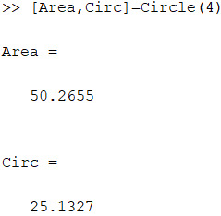
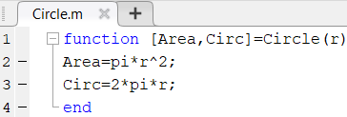
Multiple Outputs
A function may have more than one output. These are enclosed in square brackets.
For example, the function circle computes the area A and circumference C of a circle, given its radius as an input argument.
function [A, C] = circle(r)
A = pi*r.^2;
C = 2*pi*r;
end

Slide 35
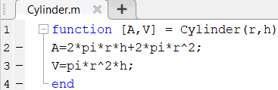
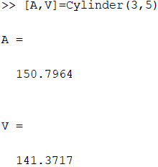
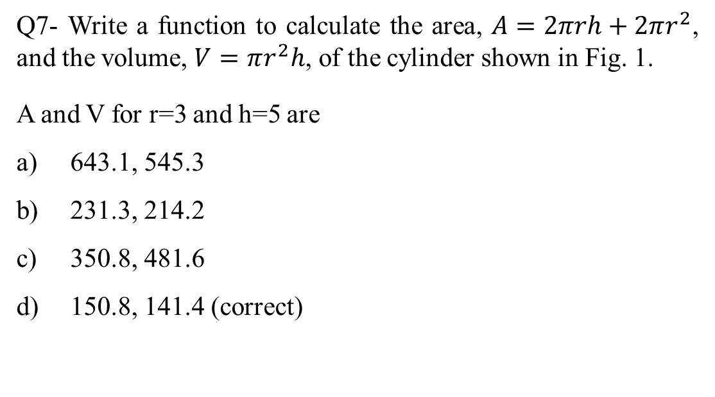
Question 7
Q7- Write a function to calculate the area, $A=2πrh+2πr^{2}$, and the volume, $V=πr^{2}h$, of the cylinder shown in Fig. 1.
A and V for r=3 and h=5 are
643.1, 545.3
231.3, 214.2
350.8, 481.6
150.8, 141.4 (correct)

Slide 36
Example of No Inputs and No Outputs
A function may have no input arguments and no output list.
For example, the function show_date clears all variables, clears the screen, computes and stores the date in the variable today, and then displays the value of today.
function show_date
clear
clc
today = date
end

Slide 37
Examples of Function Definition Lines
One input, one output:
function [area_square] = square(side)
Brackets are optional for one input, one output:
function area_square = square(side)
Three inputs, one output:
function [volume_box] = box(height,width,length)
One input, two outputs:
function [area_circle,circumf] = circle(radius)
No named output: function sqplot(side)

Slide 38
Function Example 1
function [dist,vel] = drop(g,vO,t);
% Computes the distance travelled and the
% velocity of a dropped object,
% as functions of g,
% the initial velocity vO, and
% the time t.
vel = g*t + vO;
dist = 0.5*g*t.^2 + vO*t;
end

Slide 39
Function Example 2
The variable names used in the function definition may, but need not, be used when the function is called:
>>a = 32.2;
>>initial_speed = 10;
>>time = 5;
>>[feet_dropped,speed] = . . . drop(a,initial_speed,time)

Slide 40
Function Example 3
The input variables need not be assigned values outside the function prior to the function call:
[feet_dropped,speed] = drop(32.2,10,5)
The inputs and outputs may be arrays:
[feet_dropped,speed]=drop(32.2,10,0:1:5)
This function call produces the arrays feet_dropped and speed, each with six values corresponding to the six values of time in the array time.

Slide 41
Local Variables 2
The names of the input variables given in the function definition line are local to that function.
This means that other variable names can be used when you call the function.
All variables inside a function are erased after the function finishes executing, except when the same variable names appear in the output variable list used in the function call.

Slide 42
Global Variables
The global command declares certain variables global, and therefore their values are available to the basic workspace and to other functions that declare these variables global.
The syntax to declare the variables a, x, and q is
global a x q
Any assignment to those variables, in any function or in the base workspace, is available to all the other functions declaring them global.

Slide 43
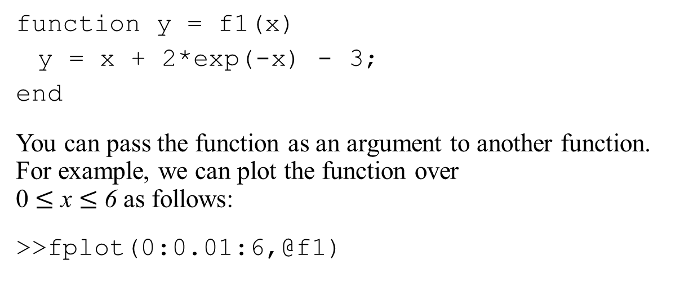
Function Handles 1
You can create a function handle to any function by using the at sign, @, before the function name. You can then use the handle to reference the function. To create a handle to the
function
, define the following function file:
function y = f1(x)
y = x + 2*exp(-x) - 3;
end
You can pass the function as an argument to another function. For example, we can plot the function over 0 $≤$ x $≤$ 6 as follows:
>>fplot(0:0.01:6,@f1)

Slide 44
Finding Zeros of a Function
You can use the fzero function to find the zero of a function of a single variable, which is denoted by x. One form of its syntax is
fzero(@function, x0)
where @function is the function handle for the function function, and x0 is a user-supplied guess for the zero.
The fzero function returns a value of x that is near x0.
It identifies only points where the function crosses the x-axis, not points where the function just touches the axis.
For example, fzero(@cos,2) returns the value 1.5708.

Slide 45
Using fzero with User-Defined Functions 1
To use the fzero function to find the zeros of more complicated functions, it is more convenient to define the function in a function file.
For example, if
, define the following
function file:
function y = f1(x)
y = x + 2*exp(-x) - 3;
end

Slide 46
Using fzero with User-Defined Functions 2
Plotting the function
shows that there is a
zero near x = −0.5 and one near x = 3.
To find a more precise value of the zero near x = −0.5, type
>>x = fzero(@f1,-0.5)
The answer is x = −0.5881.

Slide 47
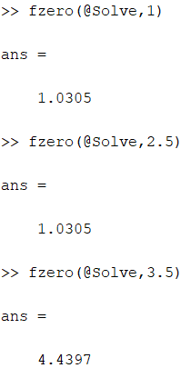


Question 8
The equation $e^{−0.1x}sin⁡(x + 2) = 0.1$has two solutions in the interval $1 < x <5$. The solutions are.
1.03, 4.43 (correct)
2, 6.7
3, 7.5
4, 9.4

Slide 48
Finding the Minimum of a Function 1
The fminbnd function finds the minimum of a function of a single variable, which is denoted by x. One form of its syntax is
fminbnd(@function, x1, x2)
where @function is the function handle for the function. The fminbnd function returns a value of x that minimizes the function in the interval x1 ≤ x ≤ x2.
For example, fminbnd(@cos,0,4) returns the value 3.1416.

Slide 49
Finding the Minimum of a Function 2
When using fminbnd it is more convenient to define the
function in a function file. For example, if
define the following function file:
function y = f2(x)
y = 1-x.*exp(-x);
To find the value of x that gives a minimum of y for 0 ≤ x ≤ 5, type
>>x = fminbnd(@f2,0,5)
The answer is x = 1. To find the minimum value of y, type y = f2(x). The result is y = 0.6321.

Slide 50
Finding the Minimum of a Function 3
A function can have one or more local minima and a global minimum.
If the specified range of the independent variable does not enclose the global minimum, fminbnd will not find the global minimum.
fminbnd will find a minimum that occurs on a boundary.

Slide 51
Finding the Minimum of a Function 4
To find the minimum of a function of more than one variable, use the fminsearch function. One form of its syntax is
fminsearch(@function, x0)
where @function is the function handle of the function in question. The vector x0 is a guess that must be supplied by the user.

Slide 52
Finding the Minimum of a Function 5
, we first define it in an M-
To minimize the function
file, using the vector x whose elements are x(1) = x and x(2) = y.
function f = f4(x)
f = x(1).*exp(-x(1).^2-x(2).^2);
end
Suppose we guess that the minimum is near x = y = 0. The session is
>>fminsearch(@f4,[0,0])
ans =
-0.7071 0.000
Thus the minimum occurs at x = −0.7071, y = 0.

Slide 53

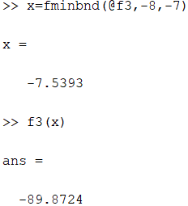

Question 9
The function $y =0.5 + e^{−0.6x}sin⁡(3x + 2)$has one minimum point in the interval $−8 < x < −7$. Find the value of x at the minimum.
-7.23
-7.35
-7.53 (correct)
-7.78
Plot

Slide 54

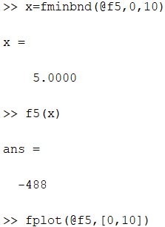
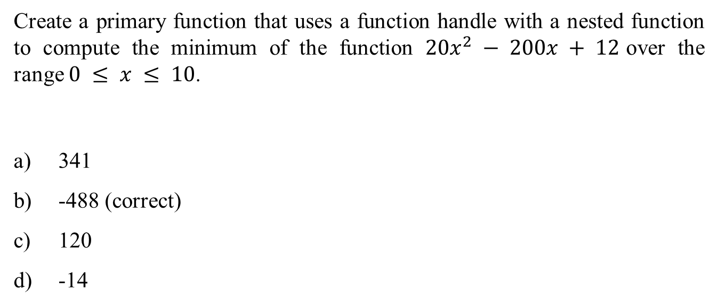
Question 10
Create a primary function that uses a function handle with a nested function to compute the minimum of the function $20x^{2} − 200x + 12$over the range $0 ≤ x ≤ 10$.
341
-488 (correct)
120
-14
Plot

Slide 55

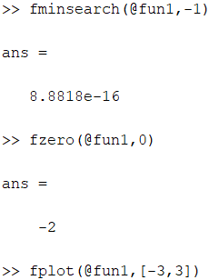
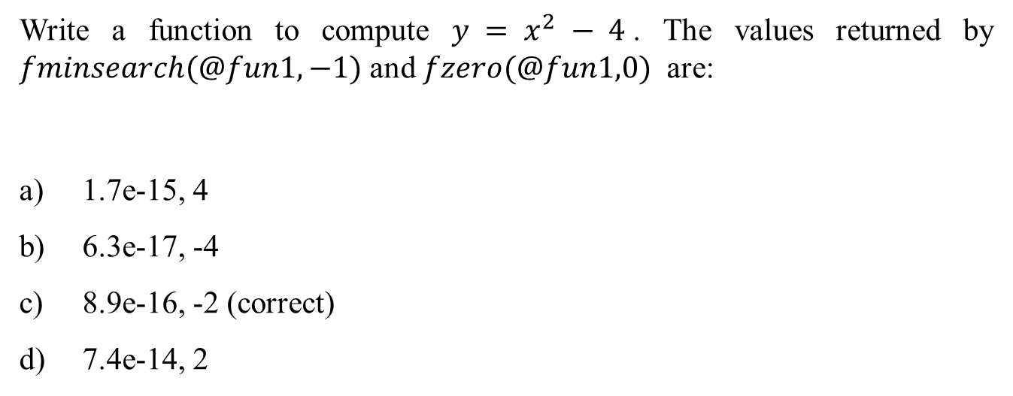
Question 11
Write a function to compute $y = x^{2} − 4$. The values returned by $fminsearch(@fun1,−1)$ and $fzero(@fun1,0)$ are:
1.7e-15, 4
6.3e-17, -4
8.9e-16, -2 (correct)
7.4e-14, 2
Plot

Slide 56

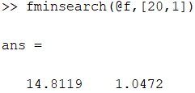
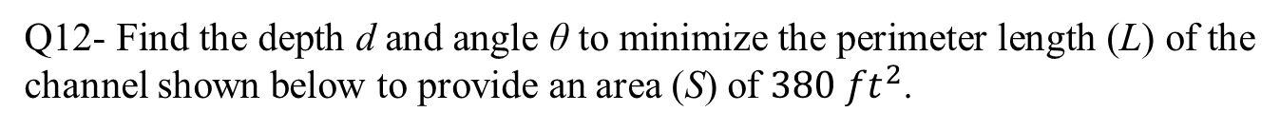
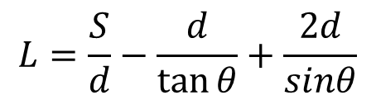
Question 12
Q12- Find the depth d and angle θ to minimize the perimeter length (L) of the channel shown below to provide an area (S) of $380 {ft}^{2}$.
$$L=\frac{S}{d}−\frac{d}{\tan{θ}}+\frac{2d}{sinθ}$$
d= 24.7 θ = 1.24 rad
d= 12.6 θ = 1.12 rad
d= 18.9 θ = 1.41 rad
d= 14.8 θ = 1.04 rad (correct)

Slide 57
Function Handles 2
One way to invoke, or “call,” a function into action is to use a function handle @. Consider the fzero function used with the user-defined function fun1, which computes
>>[x, value] = fzero(@fun1,[0, 3])

Slide 58
Anonymous Functions 1
Anonymous functions enable you to create a simple function without needing to create an M-file for it. You can construct an anonymous function either at the MATLAB command line or from within another function or script. The syntax for creating an anonymous function from an expression is
fhandle = @(arglist) expr
where arglist is a comma-separated list of input arguments to be passed to the function, and expr is any single, valid MATLAB expression.

Slide 59
Anonymous Functions 2
To create a simple function called sq to calculate the square of a number, type
>>sq = @(x) x.^2;
To improve readability, you may enclose the expression in parentheses, as sq = @(x) (x.^2);. To execute the function, type the name of the function handle, followed by any input arguments enclosed in parentheses. For example,
>>sq([5,7])
ans =
25 49

Slide 60
Anonymous Functions 3
You might think that this particular anonymous function will not save you any work because typing sq([5,7]) requires nine keystrokes, one more than is required to type [5,7].^2.
Here, however, the anonymous function protects you from forgetting to type the period (.) required for array exponentiation.
Anonymous functions are useful, however, for more complicated functions involving numerous keystrokes.

Slide 61
Anonymous Functions 4
You can pass the handle of an anonymous function to other functions. For example, to find the minimum of the polynomial
over the interval
you type
>>poly1 = @(x) 4*x.^2 - 50*x + 5;
>>fminbnd(poly1, -10, 10)
ans =
6.2500
If you are not going to use that polynomial again, you can omit the handle definition line and type instead
>>fminbnd(@(x) 4*x.^2 - 50*x + 5, -10, 10)

Slide 62
Multiple Input Arguments 1
You can create anonymous functions having more than one input. For example, to define the function
√
, type
>>sqrtsum = @(x,y) sqrt(x.^2 + y.^2);
Then type
>>sqrtsum(3, 4)
ans =
5

Slide 63
Multiple Input Arguments 2
As another example, consider the function defining a plane, z = Ax + By. The scalar variables A and B must be assigned values before you create the function handle. For example,
>>A = 6; B = 4:
>>plane = @(x,y) A*x + B*y;
>>z = plane(2,8)
z =
44

Slide 64
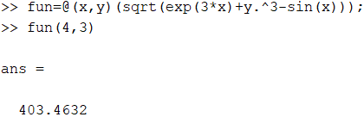

Question 13
Write an anonymous function to calculate $\sqrt{e^{3x}+y^{3}−sinx}$
The result for x=4, y=3 is
403.4 (correct)
340.2
278.9
169.4

Slide 65

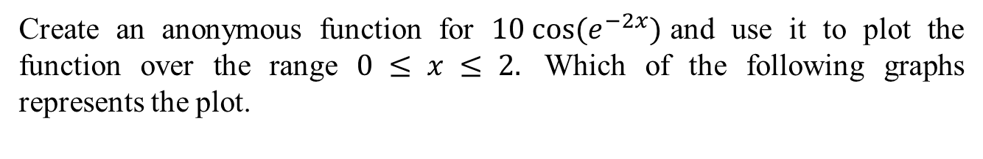
Question 14
Create an anonymous function for $10{ cos⁡(e}^{−2x})$and use it to plot the function over the range $0 ≤ x ≤ 2.$ Which of the following graphs represents the plot.

Slide 66
Calling One Function within Another
One anonymous function can call another to implement
function composition. Consider the function
It is
composed of the functions
In
the following session the function whose handle is h calls the functions whose handles are f and g.
>>f = @(x) x.^3;
>>g = @(x) 5*sin(x);
>>h = @(x) g(f(x));
>>h(2)
ans =
4.9468

Slide 67
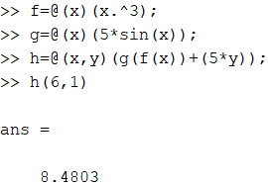

Question 15
Assume $f = @(x) x.^3$; $g = @(x) 5∗sin⁡(x)$;
Use MATLAB to calculate $h(x,y)=g(f(x))+5∗y$;
The value retuned by $h\left(6,1\right)$ is
9.7
14.2
8.48 (correct)
13.8

Slide 68
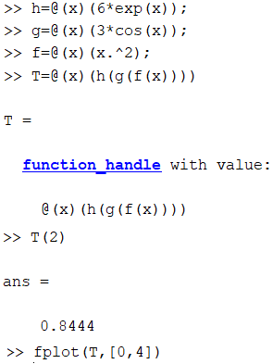
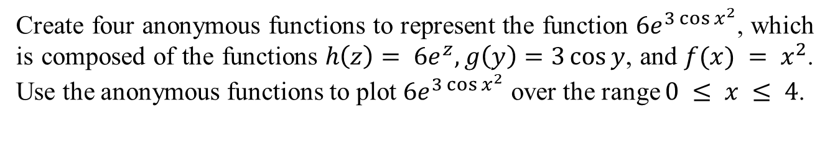
Question 16
Create four anonymous functions to represent the function $6e^{3\cos{x^{2}}}$, which is composed of the functions $h\left(z\right)= {6e}^{z}, g\left(y\right)=3\cos{y}$, and $f(x) = x^{2}$. Use the anonymous functions to plot $6e^{3\cos{x^{2}}}$ over the range $0 ≤ x ≤ 4$.

Slide 69
Variables and Anonymous Functions 1
Variables can appear in anonymous functions in two ways: As variables specified in the argument list, as for example f = @(x) x.^3;, and

Slide 70
Variables and Anonymous Functions 2
As variables specified in the body of the expression, as for example with the variables A and B in plane = @(x,y) A*x + B*y.
When the function is created MATLAB captures the values of these variables and retains those values for the lifetime of the function handle. If the values of A or B are changed after the handle is created, their values associated with the handle do not change.
This feature has both advantages and disadvantages, so you must keep it in mind.

Slide 71
The default Editor Window when creating a new function 2
Access the text alternative for slide images.
Source: MATLAB

Slide 72
Importing Spreadsheet Files
Some spreadsheet programs store data in the .wk1 format. You can use the command
M = wk1read(’filename’) to import this data into MATLAB and store it in the matrix M.
The command A = xlsread(’filename’) imports the Microsoft Excel workbook file filename.xls into the array A. The command [A, B] = xlsread(’filename’) imports all numeric data into the array A and all text data into the cell array B.

Slide 73
End of Main Content
© McGraw Hill LLC. All rights reserved. No reproduction or distribution without the prior written consent of McGraw Hill LLC.

